Slide 1
Diabetes Management
By Chris Talavera & Luis Rodriguez

Slide 2
Types of Diabetes
Type 1
Insulin Shots
Type 2
About 90 percent of people have
Gestational Diabetes
Occurs during pregnancy
Could cause diabetes for both mother and child

Slide 3

Cans/Can Not’s of Diabetes
Physical Activity
Plenty of Fiber
Whole Grains
Weight
Make healthier choices
Skip Fad Diets
When to see a doctor

Slide 4
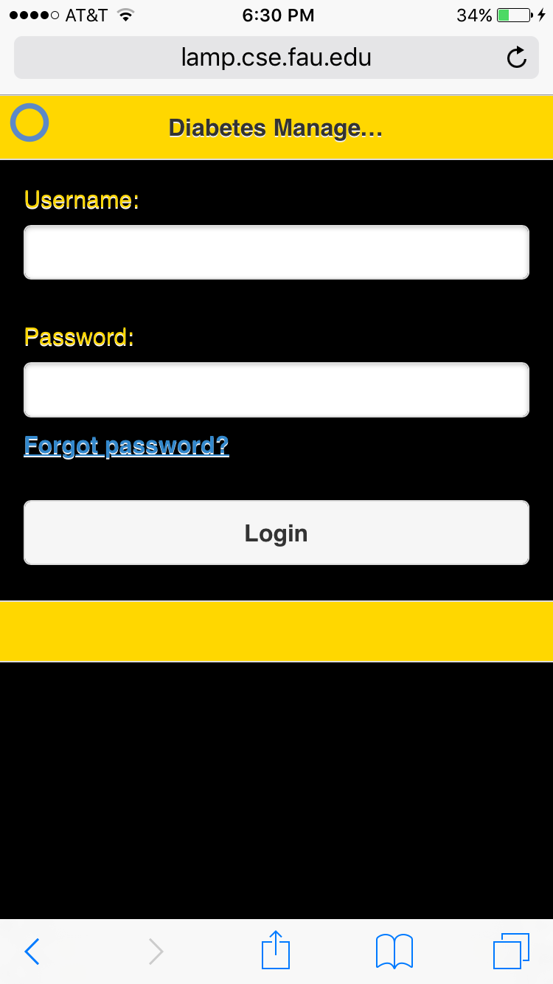
Login
Easy Access
Forgot password link
Guaranteed personal account

Slide 5
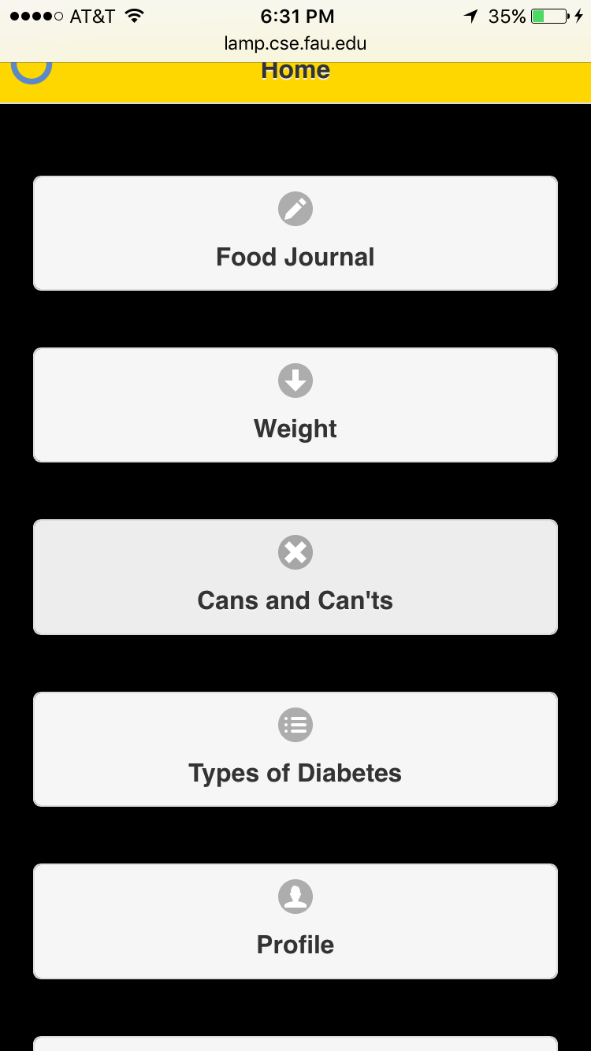
Menu Page
Access to all other pages
Profile page
Overview

Slide 6
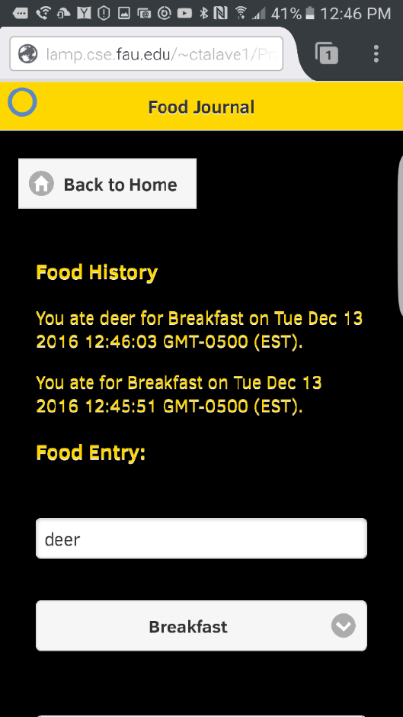
Food Journal
Enter food (breakfast, lunch, dinner)
Food History
Future add to profile page for overview

Slide 7
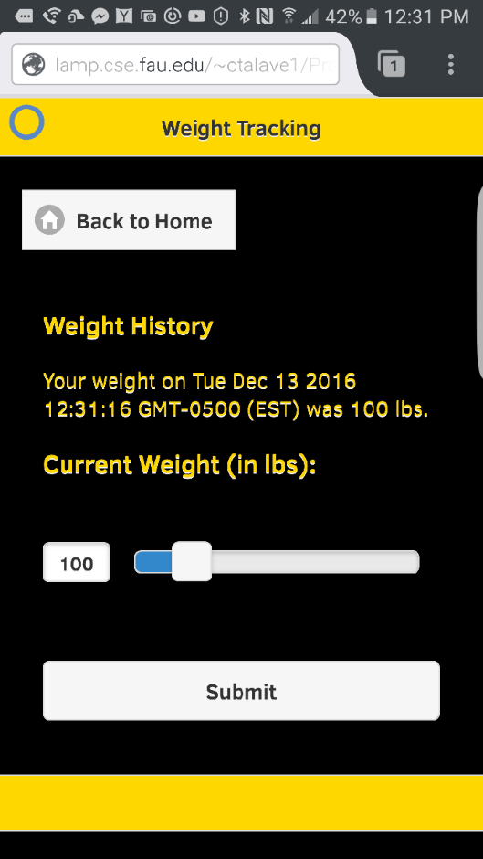
Weight Tracking
Able to use slider
View past weight history
Future add to profile page for overview
Future add chart/bar graph of weight progress (gain/loss)

